Slide 1


data science
Alireza Vafaei Sadr
Feb-2020-TeIAS

Slide 2
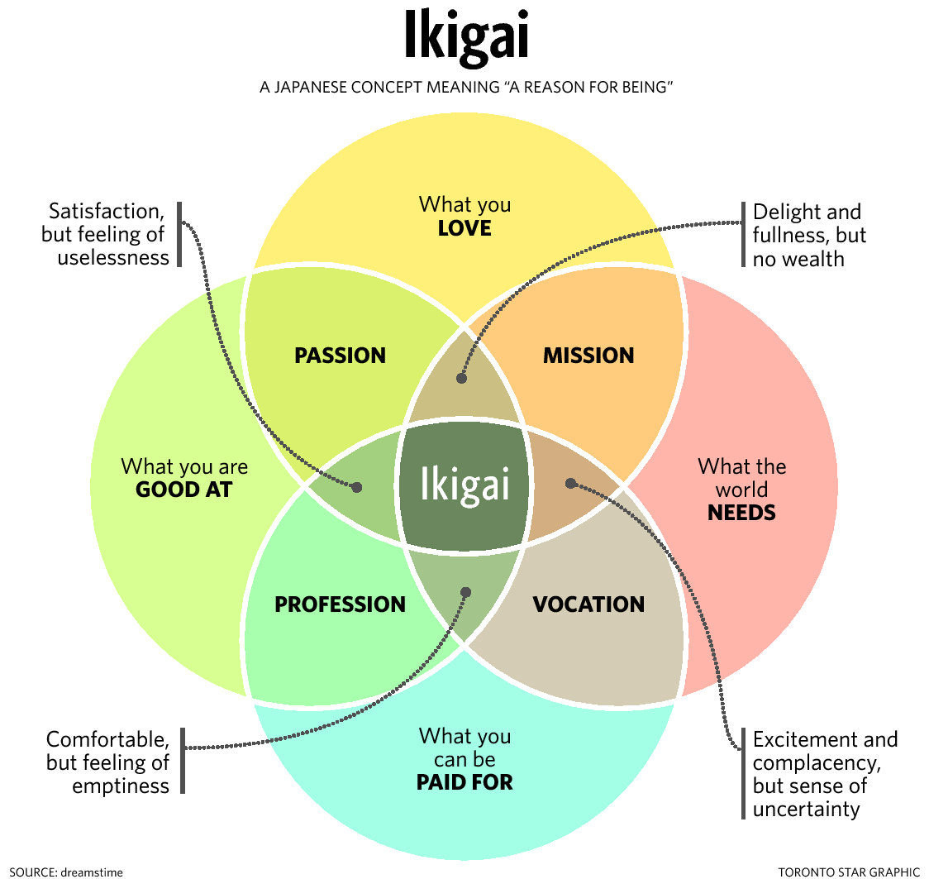

Slide 3
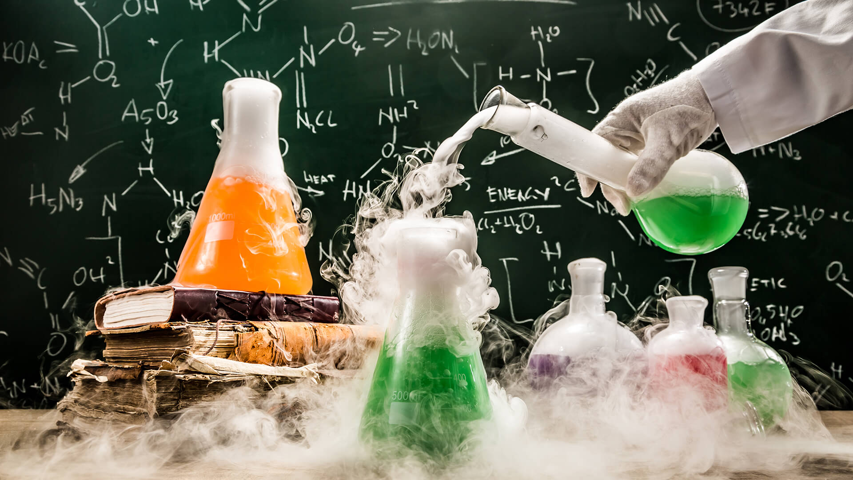

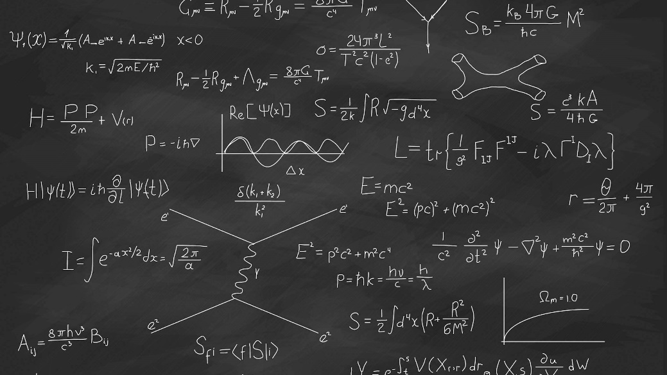
Empirical evidence
Computational science
BIG
DATA
Scientific theory
Data science

Slide 4
Data?!

Slide 5
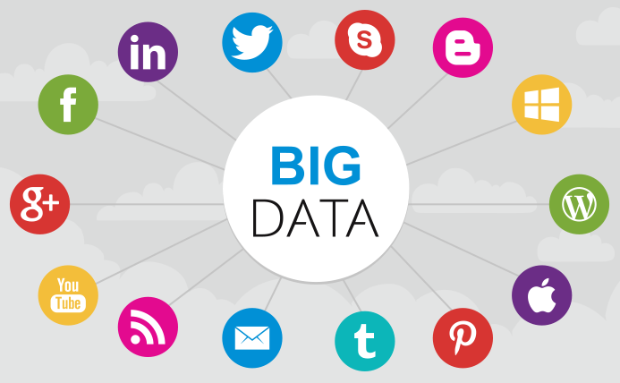



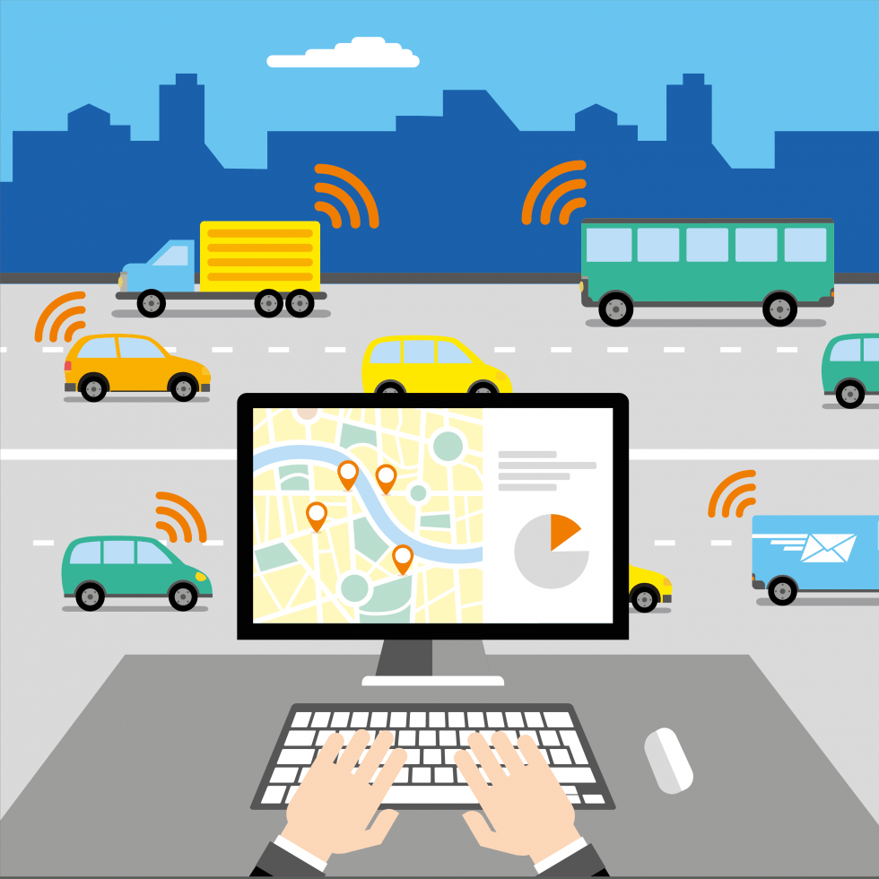




https://www.smartdatacollective.com/big-data-20-free-big-data-sources-everyone-should-know/

Slide 6
How BIG?
New telescopes collect today 50 times the info they collected 5 years ago.
Goggle process 24 PB per day = US library of congressX1000
Facebook updates 10M photos per hour and 38B like per day.
YouTube adds one hour of video every second
…

Slide 7
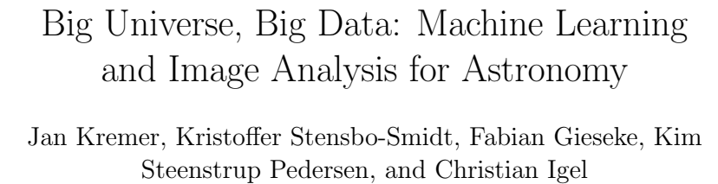
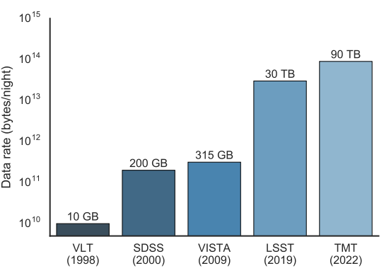
An example in Physics!

Slide 8
Do we have access to them?!

Slide 9

https://www.data.gov/

Slide 10
https://digital.nhs.uk/
https://healthdata.gov/
https://www.cia.gov/library/publications/the-world-factbook/
https://data.gov.uk/
http://data.europa.eu/euodp/en/data/
https://www.census.gov/data.html
https://trends.google.com/trends/explore
https://www.yelp.com/dataset
https://www.google.com/finance
https://data.unicef.org/
https://wiki.dbpedia.org/
https://aws.amazon.com/datasets/million-song-dataset/
https://data.worldbank.org/
https://www.kaggle.com/datasets
https://www.who.int/gho/database/en/
https://www.google.com/publicdata/directory
https://lodum.de/
https://registry.opendata.aws/
https://archive.ics.uci.edu/ml/index.php
https://data.fivethirtyeight.com/

Slide 11
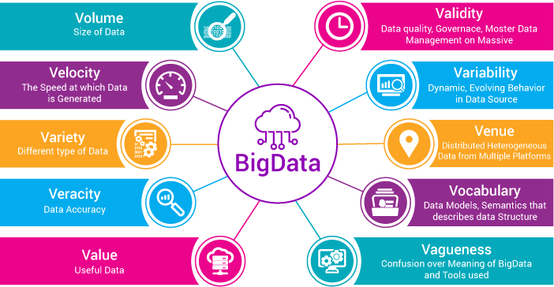
https://www.xenonstack.com/blog/ingestion-processing-big-data-iot-stream/

Slide 12
Science?!

Slide 13
data research:
Hypothesis-Driven: What kind of data do we need to help solve a problem?
Data-Driven: What interesting problems can be solved with this data!?

Slide 14
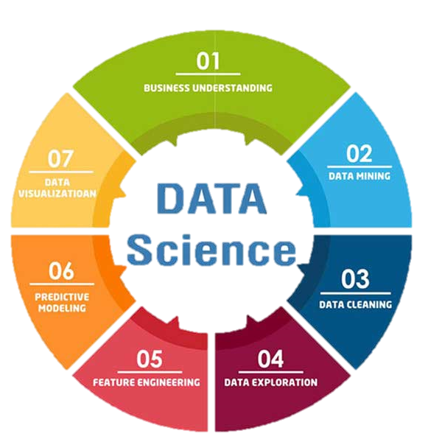
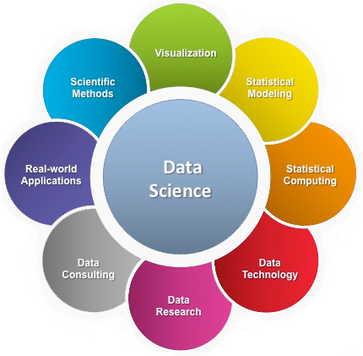

Slide 15
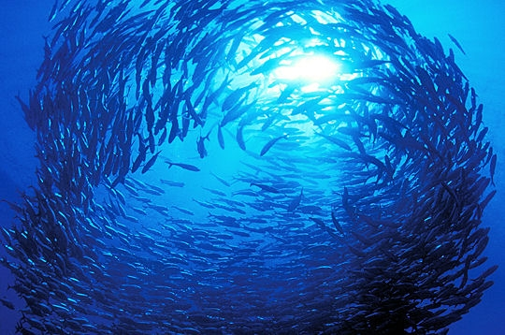
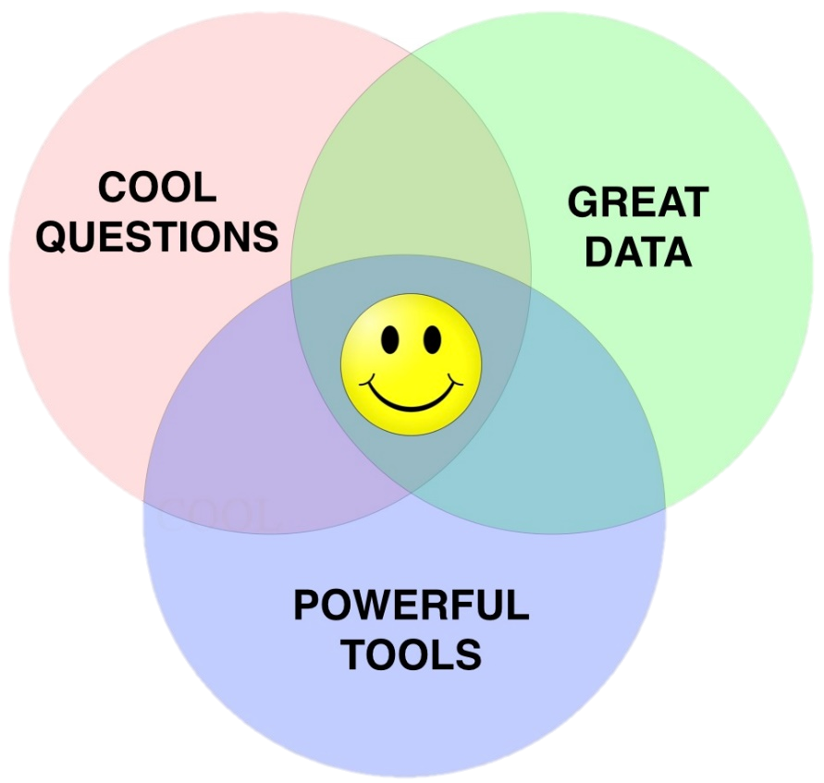
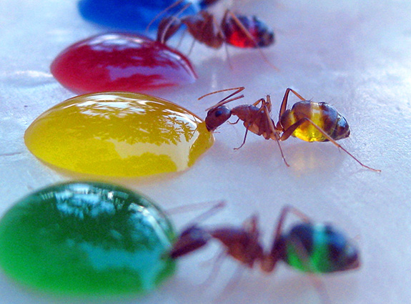

Slide 16
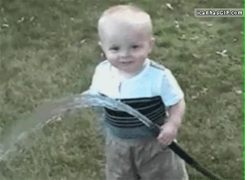
Better half a loaf than no bread.
آب دریا را اگر نتوان کشید هم به قدر تشنگی باید چشید

Slide 17
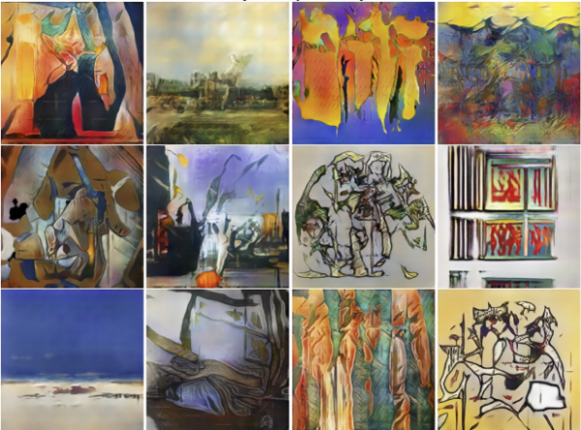
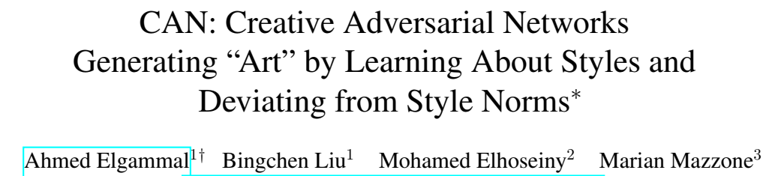
Creativity!

Slide 18
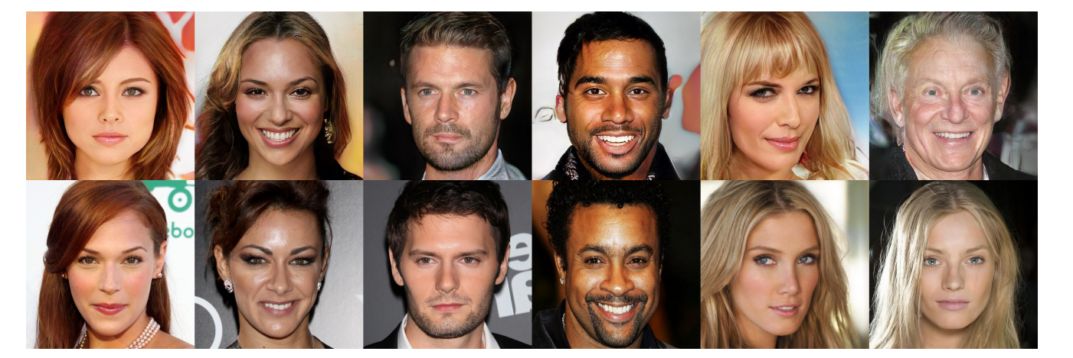
Creativity!
https://towardsdatascience.com/do-gans-really-model-the-true-data-distribution-or-are-they-just-cleverly-fooling-us-d08df69f25eb

Slide 19
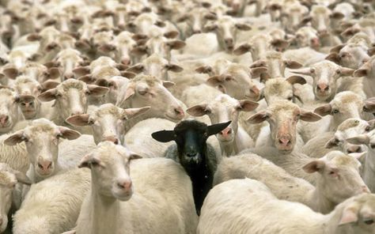
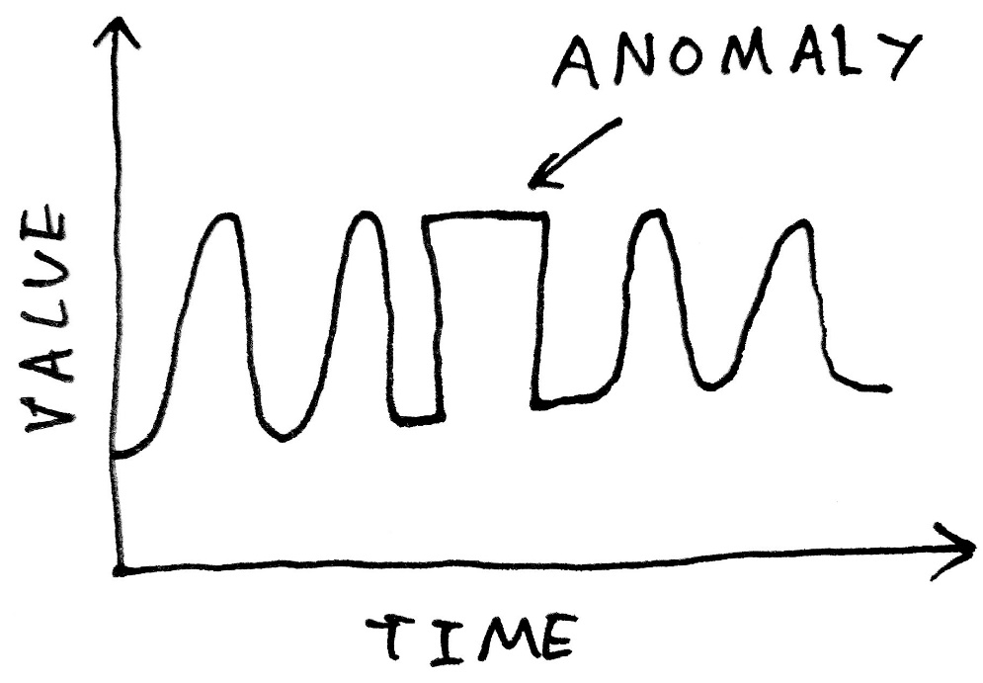
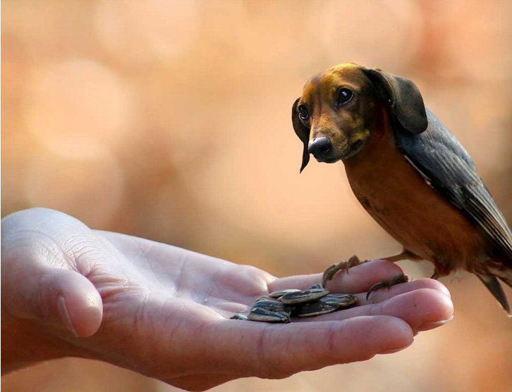
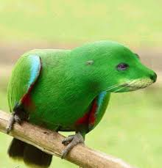
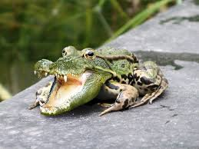
Discovery!

Slide 20
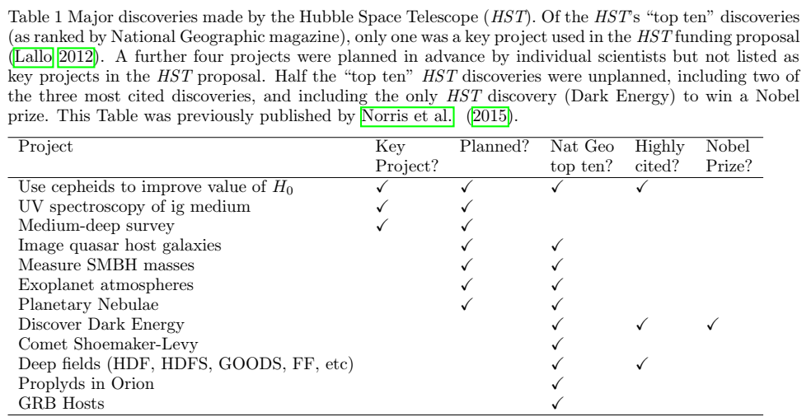
Discovery!

Slide 21
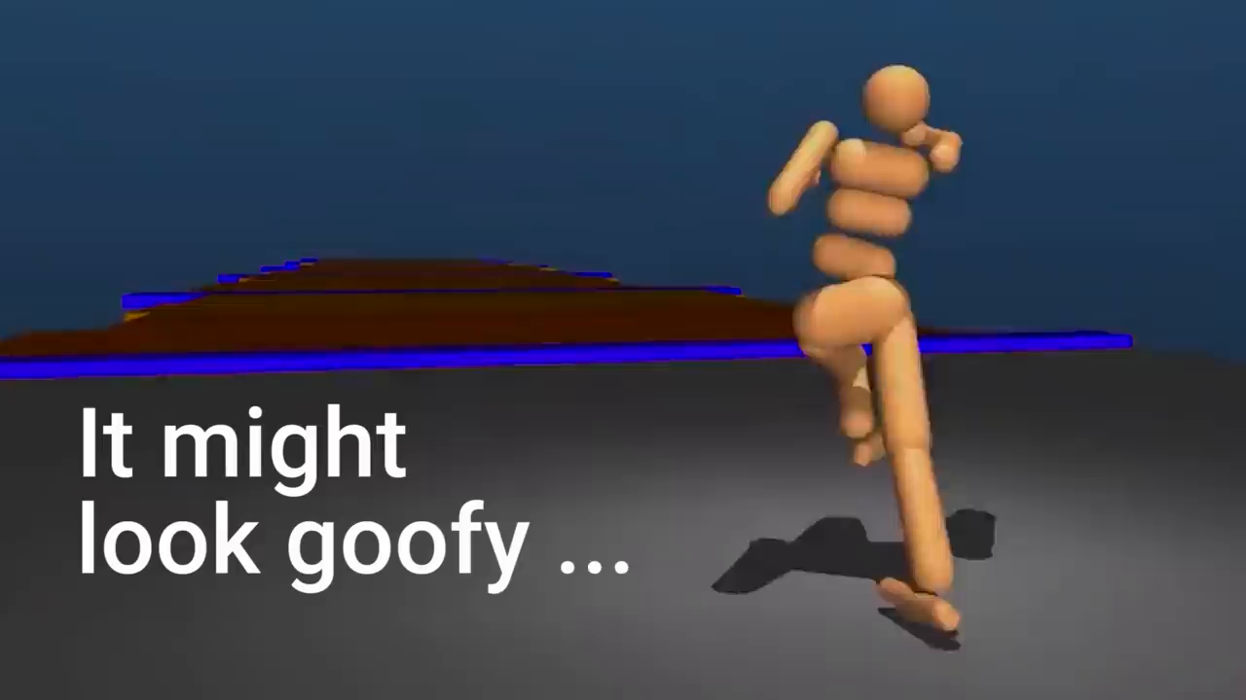
Walking! :D
Google “how google ai can play”

Slide 22
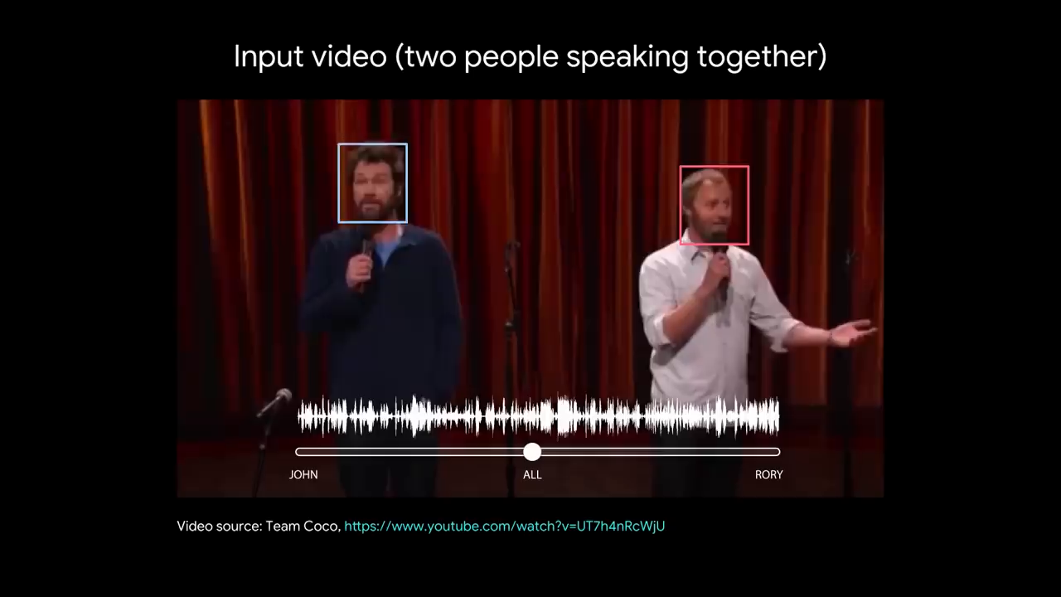
Understanding!?
Google “Audio-Visual Speech Separation”

Slide 23
I wanna be one of them!

Slide 24
Data: acquisition , structure, storage, cleaning, management …
Statistics: probability, error analysis, statistical significance …
Programming: OS, development (at least in one language) …
Machine learning: almost all of it!
Practice: (practice, experience, taste) real world examples!
You need to be passionate about data, your questions and
a lot of crazy things in programming!

Slide 25

You definitely need to
(Computer+”book”)
Be a Book Worm!

Slide 26
data acquisition:
Data Sources: Companies/Proprietary Data, APIs, Government, Academic, Web Scraping/Crawling
Types of data
Structured vs. Unstructured
Quantitative vs. Categorical
Discrete vs. Continuous
Ordinal vs. Nominal
Structure and Formats:
CSV, XML, SQL, JSON, H5
Databases

Slide 27
Statistics:
How events are alike?
How much an event is probable?
How one can compare different results?
Correlation analysis
Normalizations, compatibility
Noise, errors and artifacts
Data augmentation
Data Imputation
Outlier Detection

Slide 28
Statistics:
Monte Carlo based techniques
Distributions
Modeling
Parametric vs. Nonparametric
Supervised vs. Unsupervised
Blackbox vs. Descriptive (Prediction vs Inference)
First-Principle vs. Data-Driven
Deterministic vs. Stochastic
Flat vs. Hierarchical
Fitting

Slide 29
Model Evaluation
Metrics:
Accuracy
Precision
Recall
Absolute Error
MSE
Methods:
Cross Validation
Bootstrapping

Slide 30
Feature engineering:
Rounding
Scaling
Binning
Interactions
Transformation
Dimensionality Reduction
Encoding, Embedding

Slide 31
(machine learning) Models:
Linear Regression
Logistic Regression
DistanceBased/Network algorithms
Nearest Neighbor methods
Clustering algorithms
Naive Bayes
Ensemble methods
Random forests
SVMs
ANNs

Slide 32
Machine learning (concepts):
Training/Validating/Testing
Overfitting
Bias/Variance
Regularization
Hyperparameters

Slide 33
Artificial Neural Networks
Perceptron
Activation Functions
Optimizers
Dropout
Convolutions, Poolings
Recurrents
Regression, Classification, Detection, Segmentation …
Transfer Learning
Generative Adversarial Networks

Slide 34
How is one able to deal with this load of works?!?
One does not need to do that!
Data science does need a lot of collaboration, team work, discussion, …

Slide 35
Programming skills or how we can cook a data scientist?:
Mentioned knowledge
Computer and OS
Programming concepts
At least one hot programming language
Good awareness and understanding of various packages
Cooperative manner
A sufficient amount of confidence
And, a massive amount of enthusiasm

Slide 36
Project management, collaboration and communication skills:
GitHub
Scrum
Documentation
Visualization

Slide 37
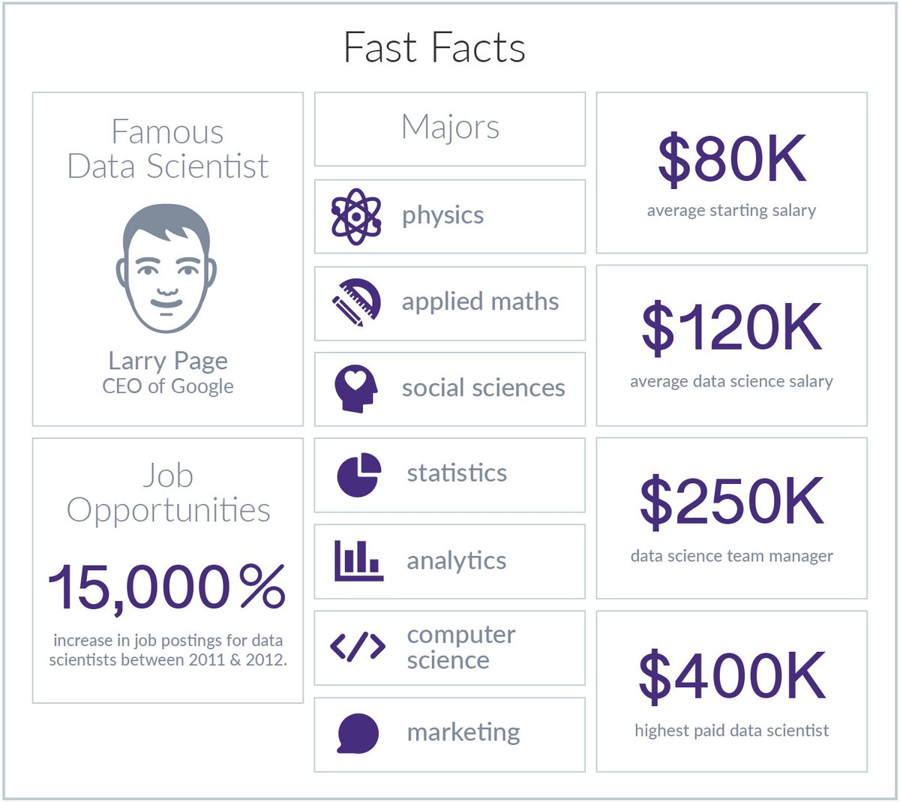

Slide 38
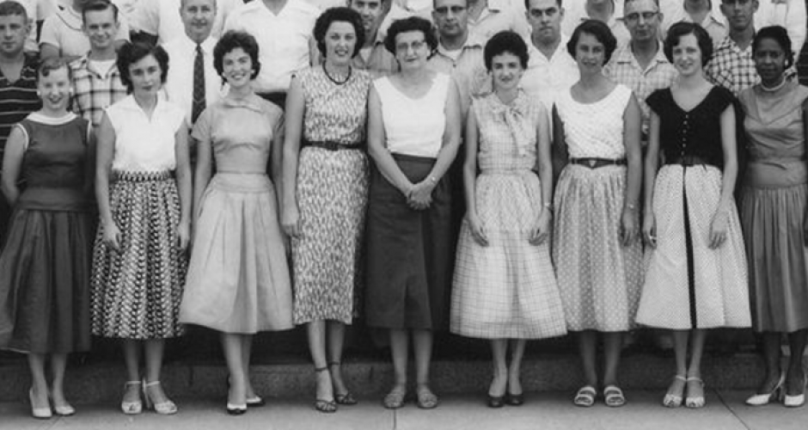
Computer:
1613-1950

Slide 39
Computer:
Logical
Arithmetic

Slide 40
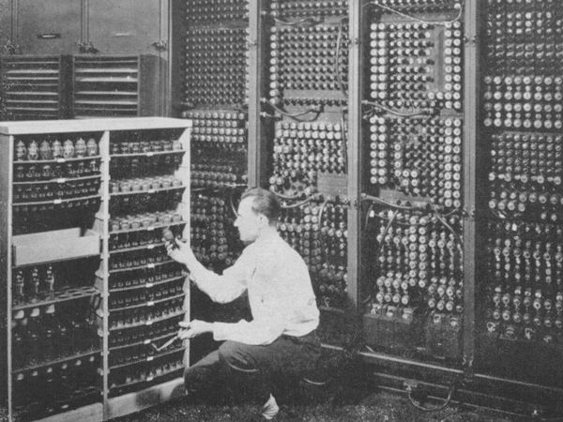
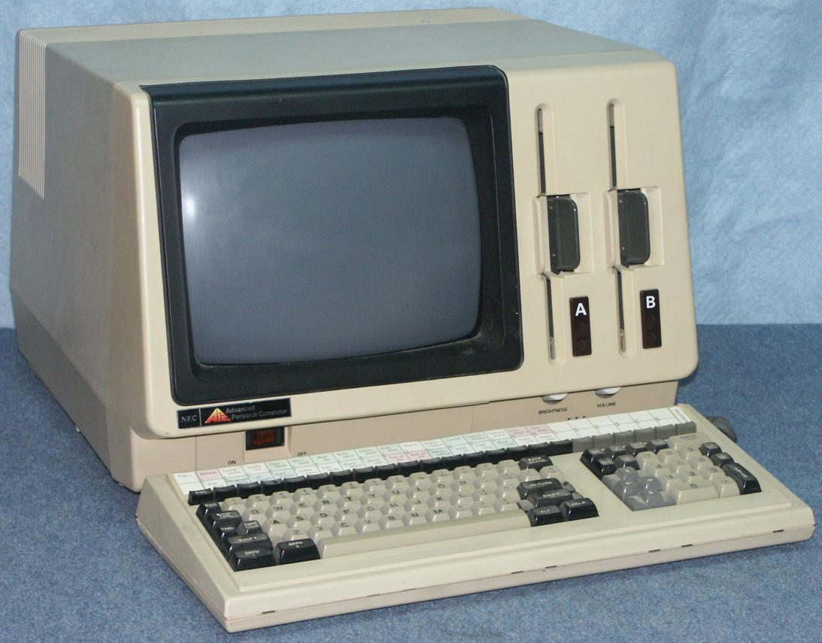
Computer:

Slide 41

Computer:

Slide 42
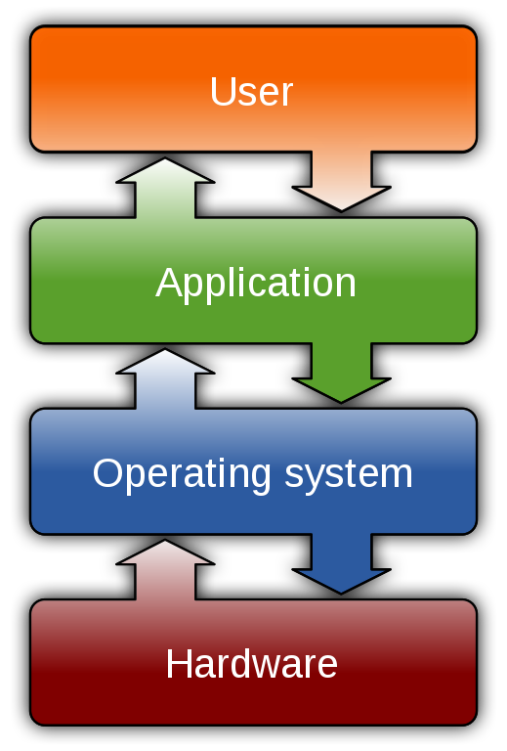


Slide 43
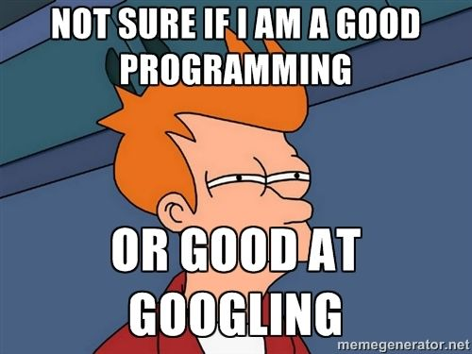

Slide 44


LET’S DIVE!

Slide 45
Thanks!

